Slide 1
Quartus
TA: Gyudong Kim
Email: gyudong_kim@korea.ac.kr

Slide 2
Installation
Install Quartus2 9.1sp2 Web Edition
For Window OS, try this.
https://bit.ly/358dqmc (91sp2_quartus_free.exe)
cf. Don’t mind the message – ‘Virus test cannot be done because this file is too large. Do you want to download it though?’
For Mac OS, try this.
Try this with material named ‘Quartus_on_m1.pdf’

Slide 3
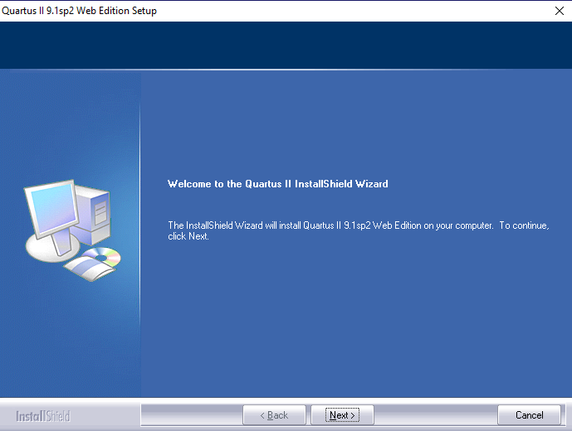
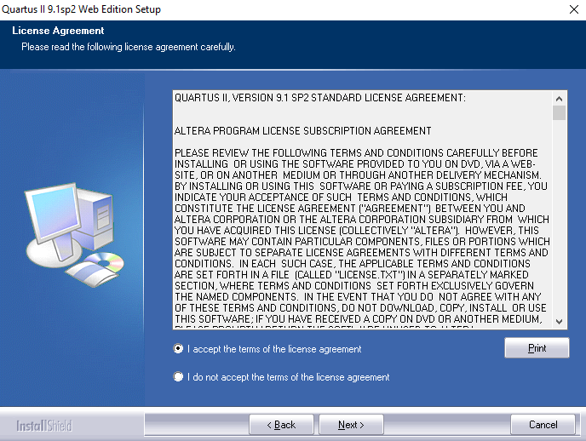
Installation
How to install Quartus?
1
2
Step 1: Click ‘Next’
Step 2: Select ‘I accept~’ button and click ‘Next’

Slide 4
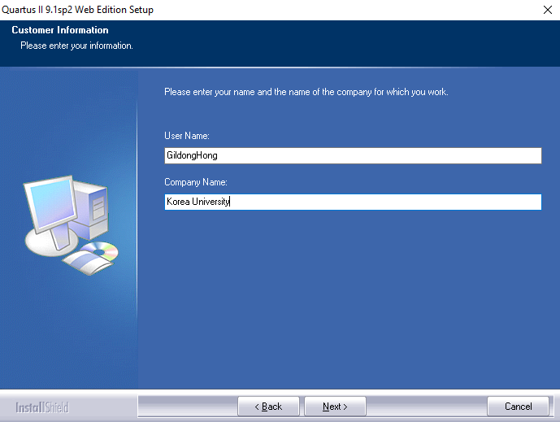
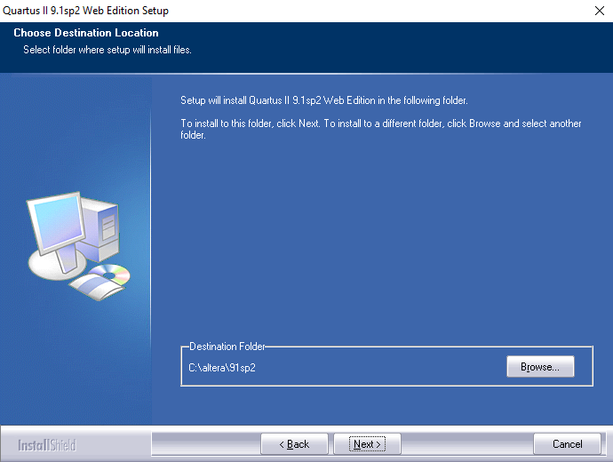
Installation
How to install Quartus?
Step 3: Put on your username(ex.GildongHong) and company name(ex.Korea University) then click ‘Next’
Step 4: Select the destination folder where the program will be installed then click ‘Next’

Slide 5
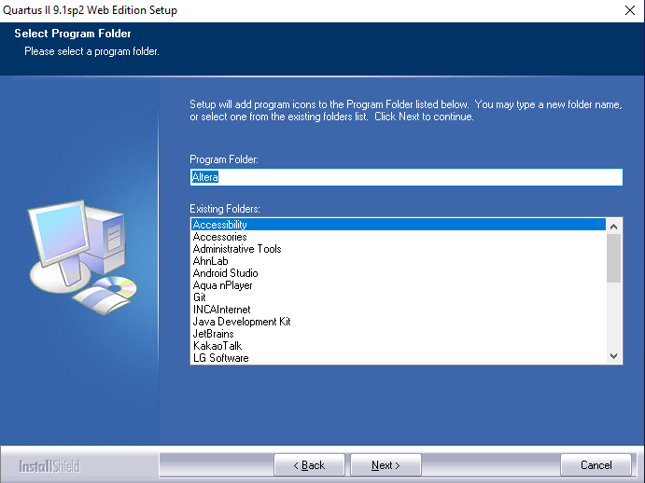
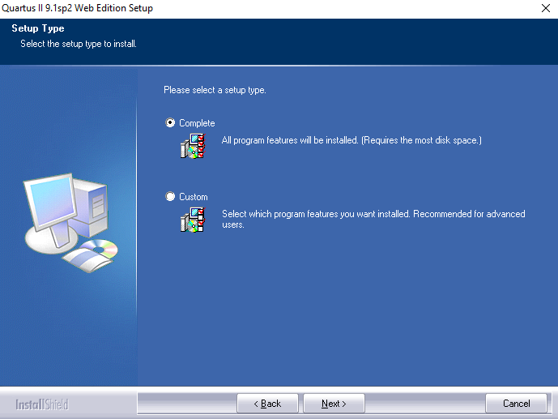
Installation
How to install Quartus?
Step 5: Select a program folder (cf. Just follow the default setting) then click ‘Next’
Step 6: Select ‘Complete’ button and click ‘Next’

Slide 6
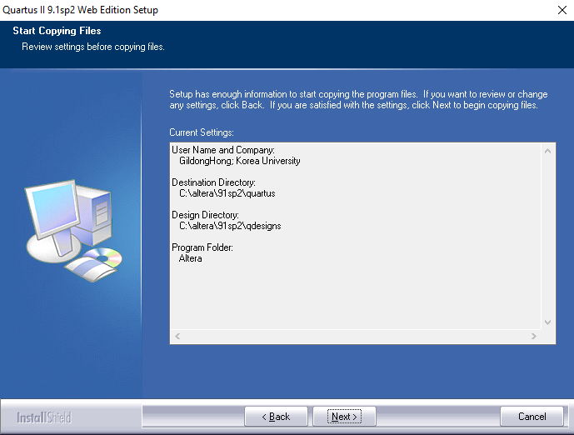

Installation
How to install Quartus?
Step 7: Review your setting

Slide 7
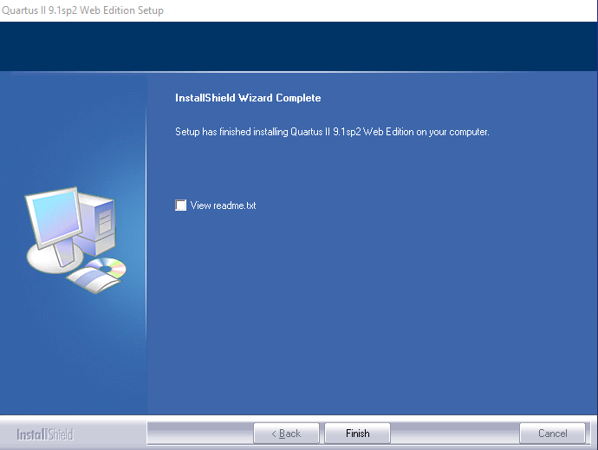
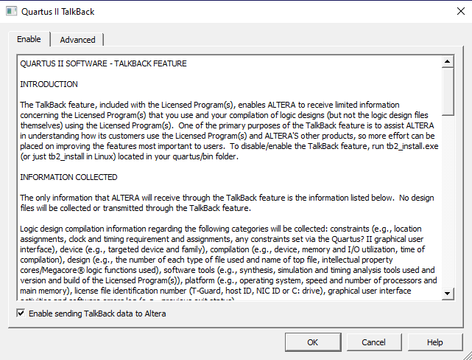
Installation
How to install Quartus?

Slide 8
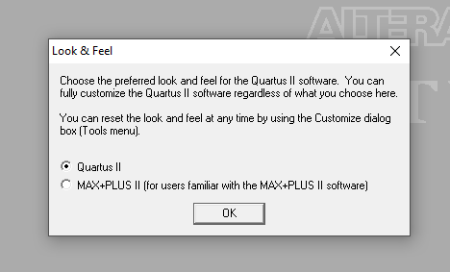
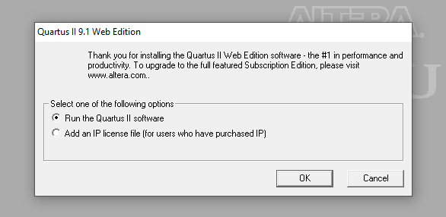
Installation
How to install Quartus?

Slide 9
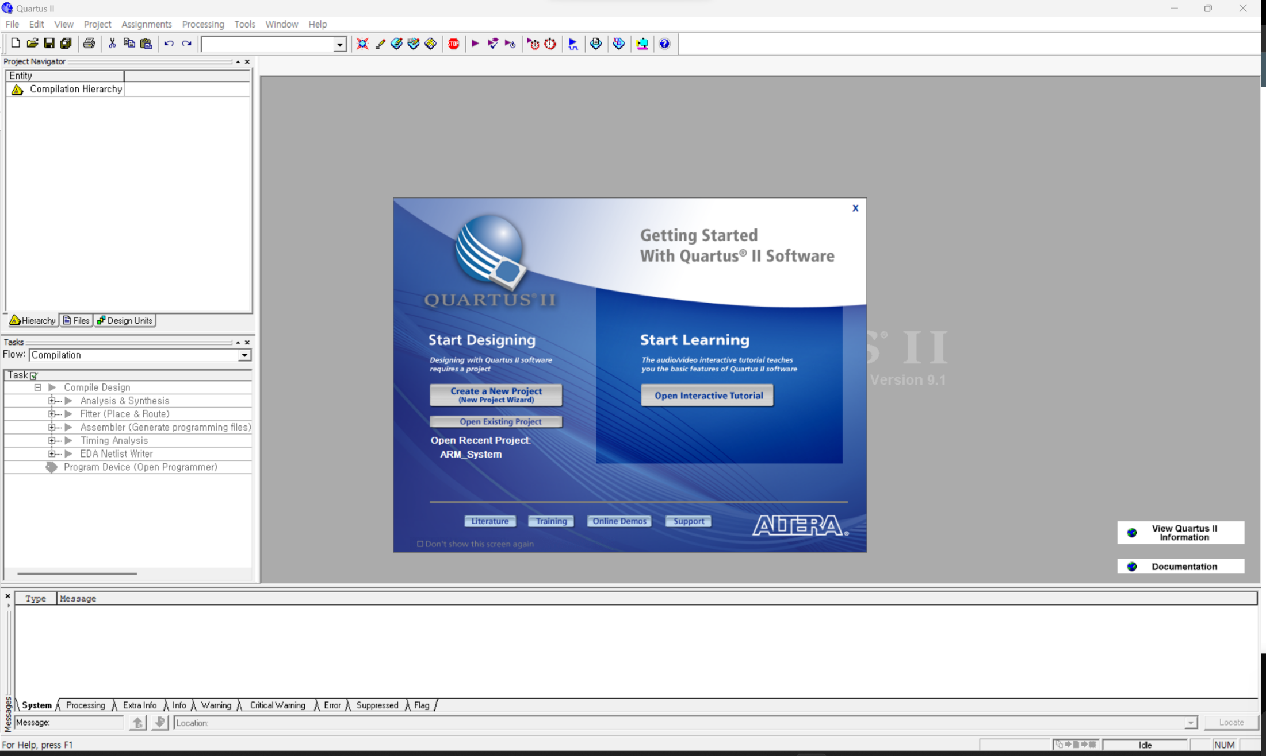
Open Existing Project

Slide 10
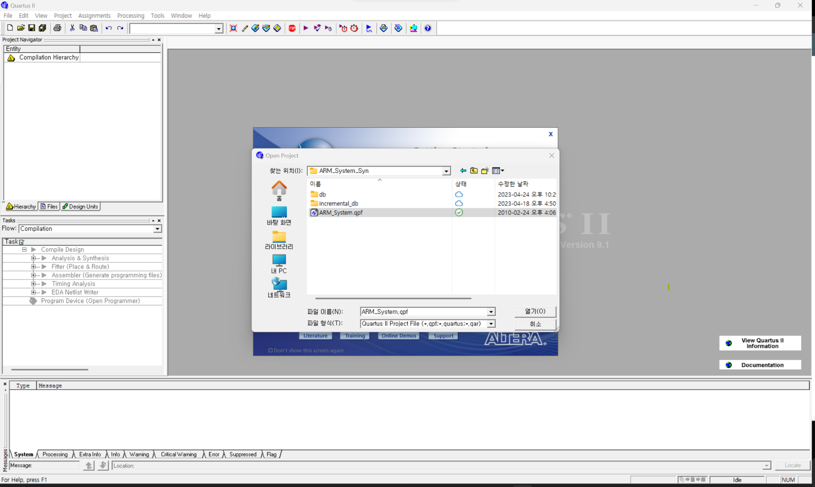
Open Existing Project
It will take some time to open the file

Slide 11
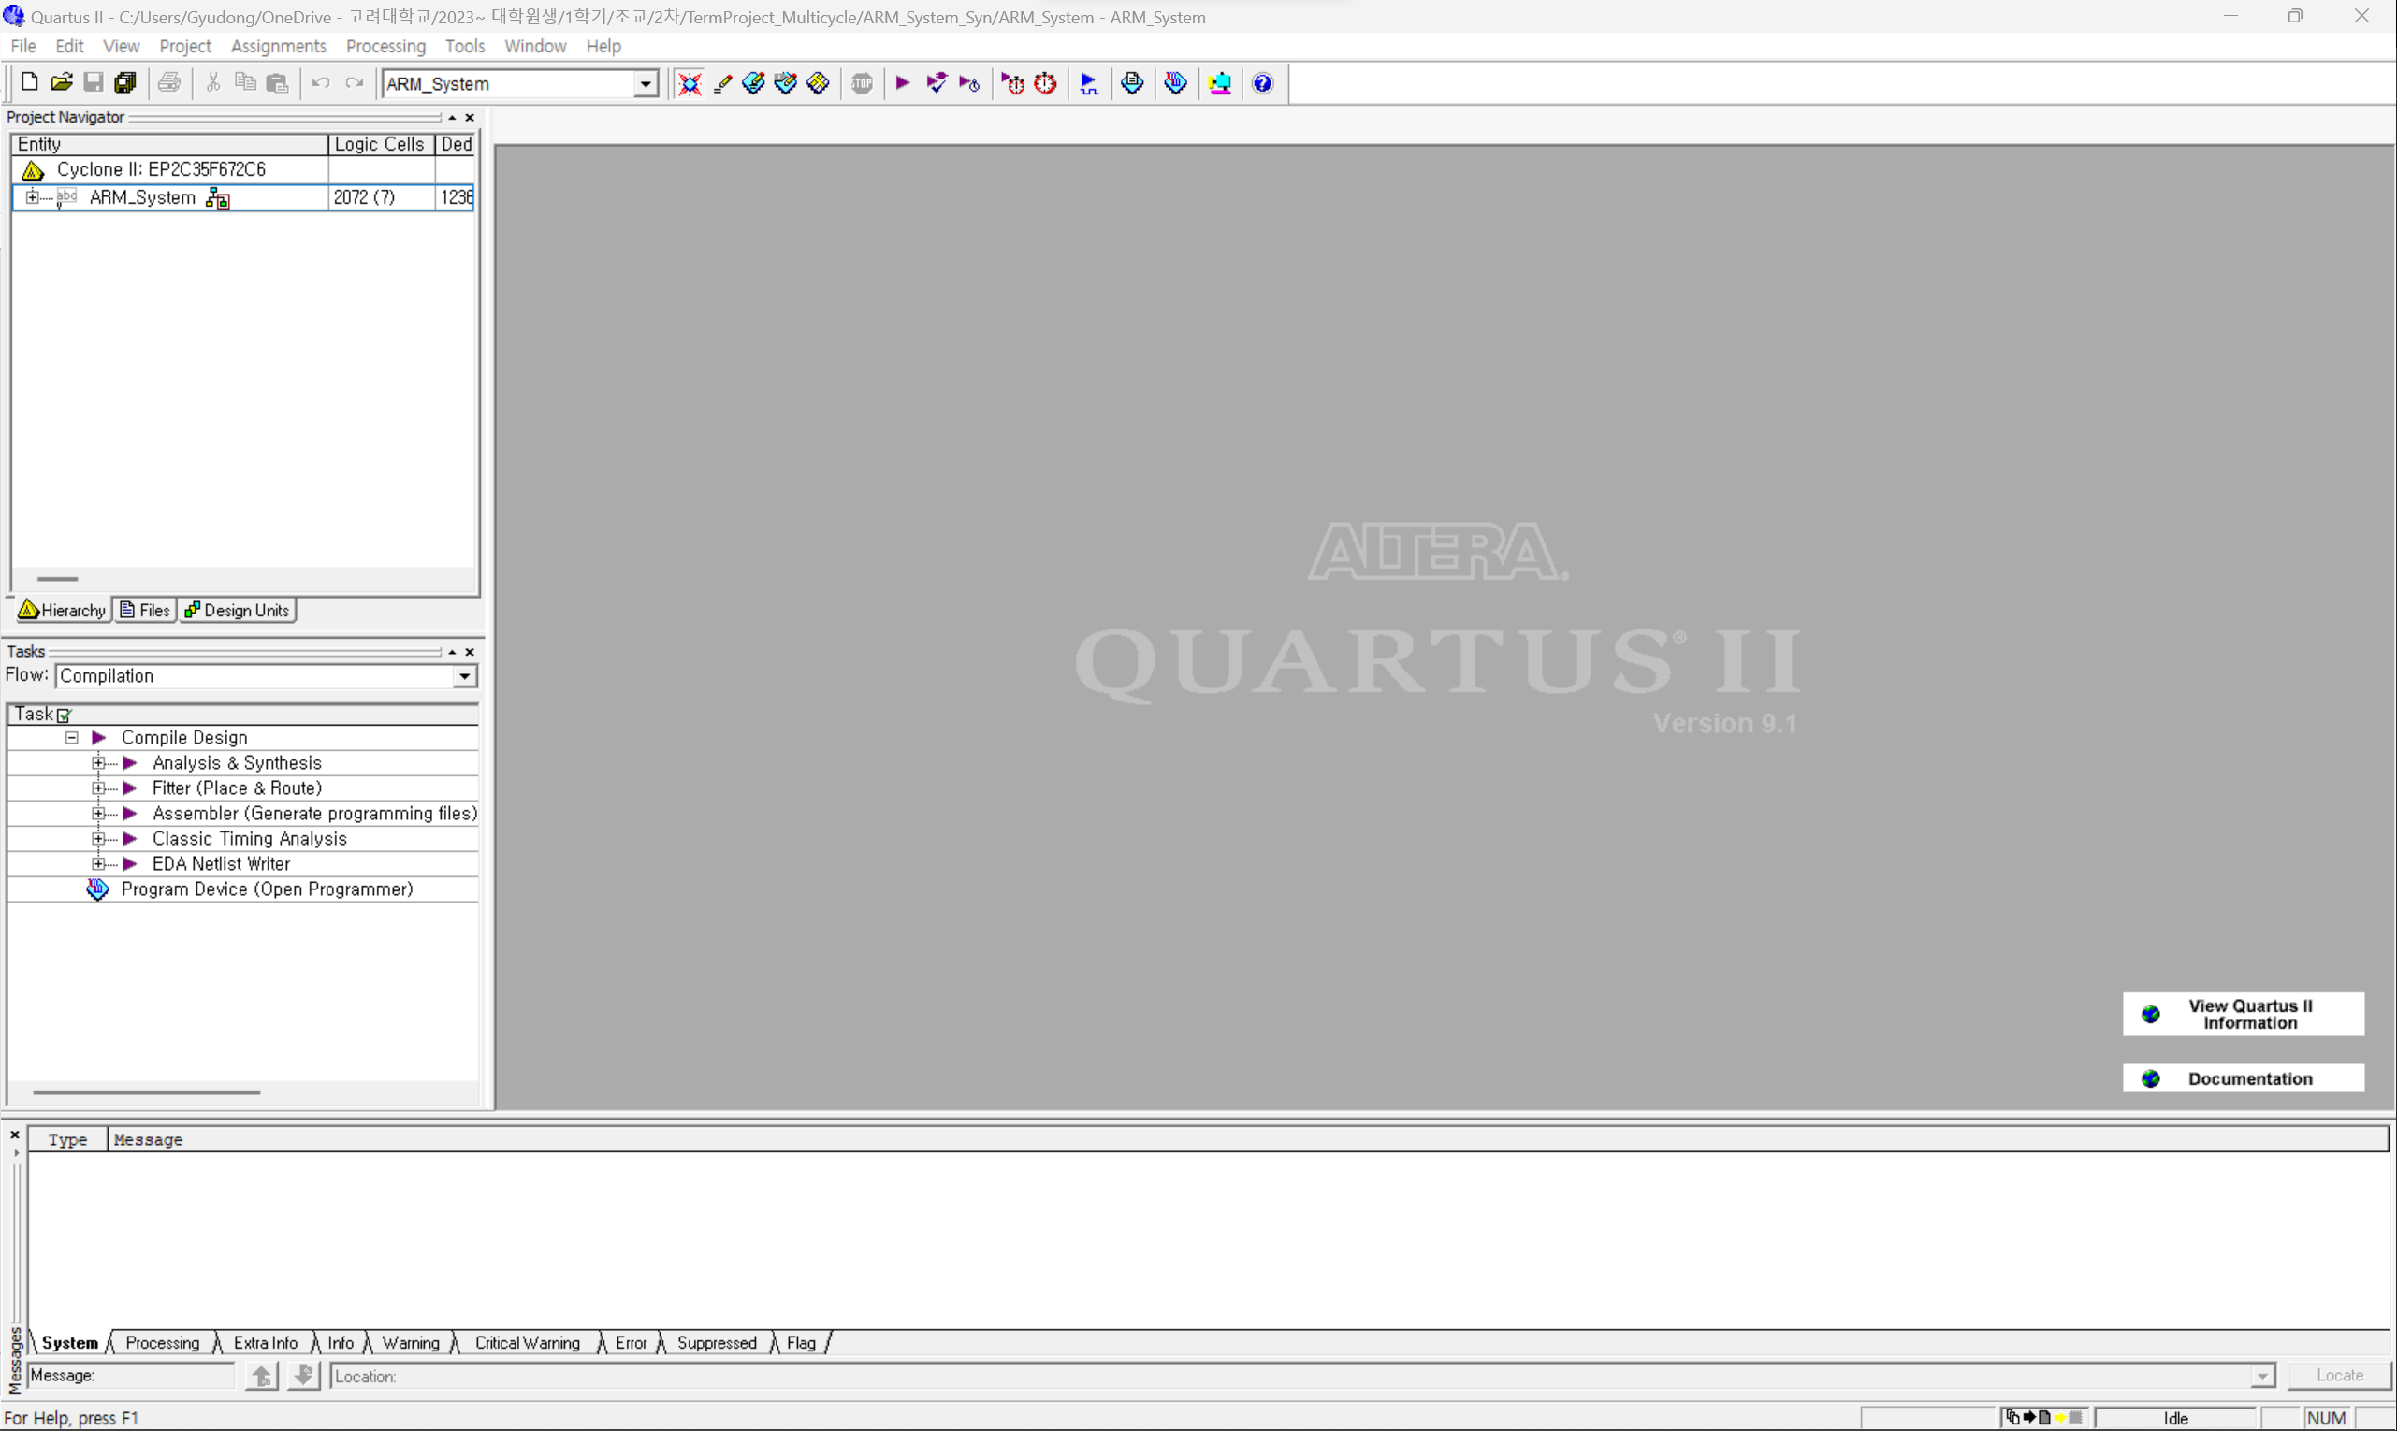
Compilation

Slide 12
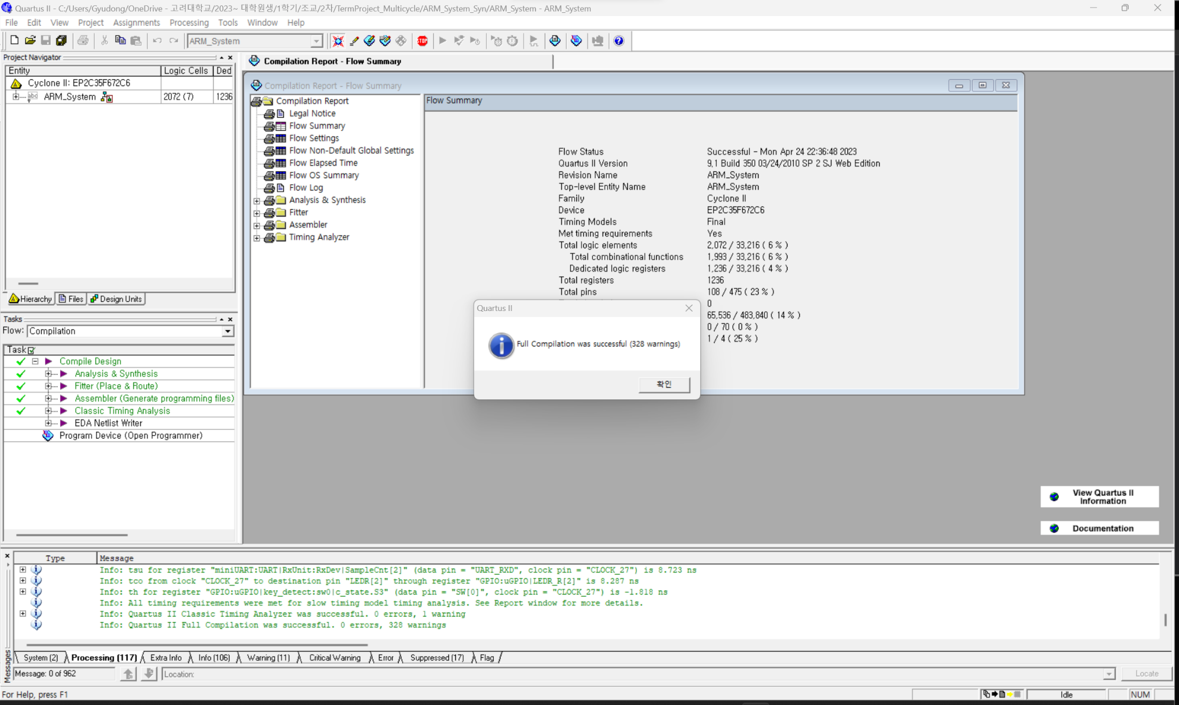
Compilation

Slide 13
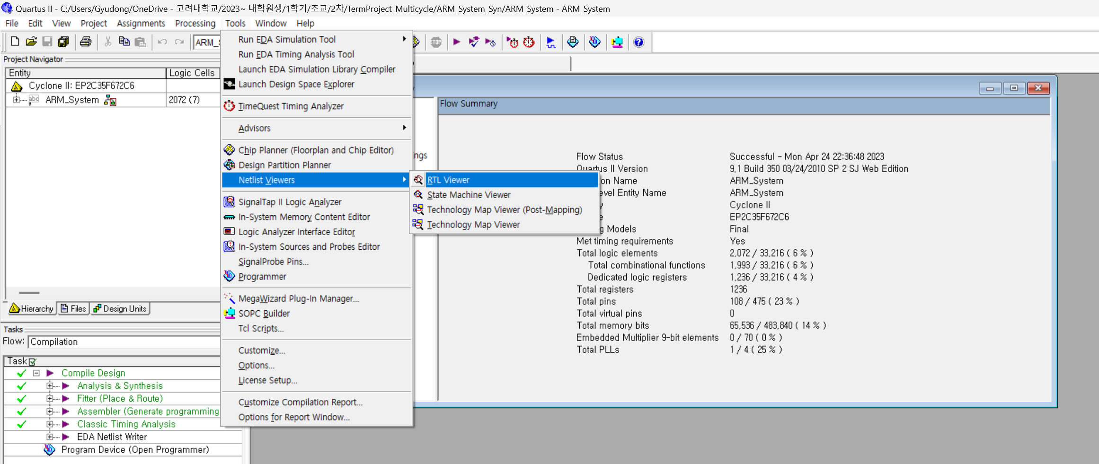
RTL Viewer

Slide 14
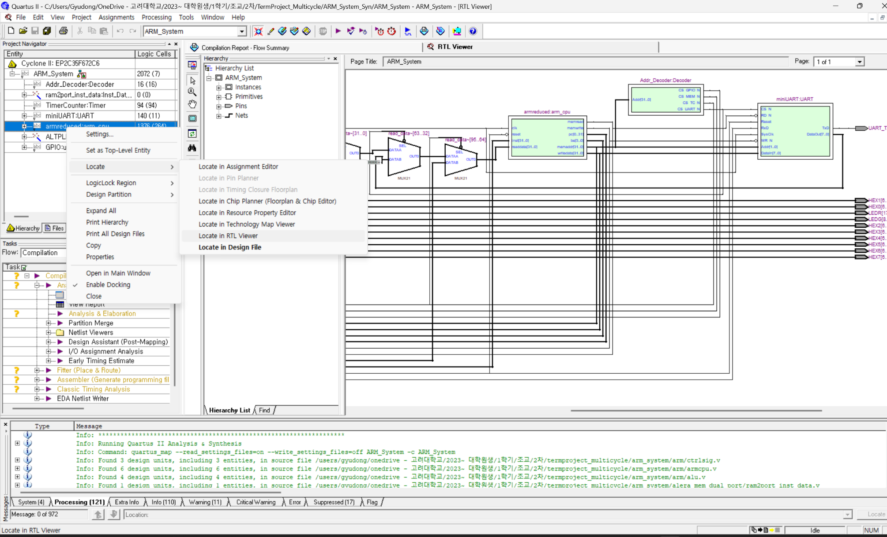
RTL Viewer

Slide 15
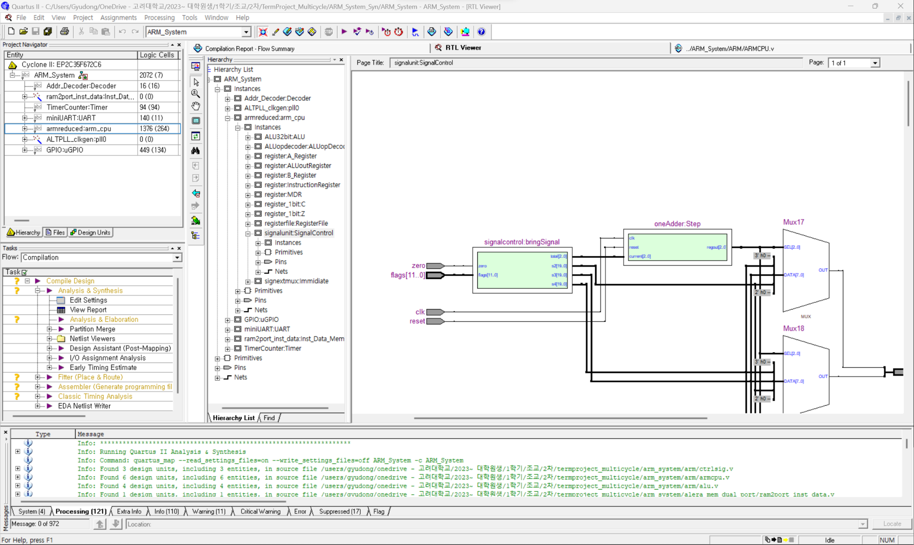
RTL Viewer

Slide 16
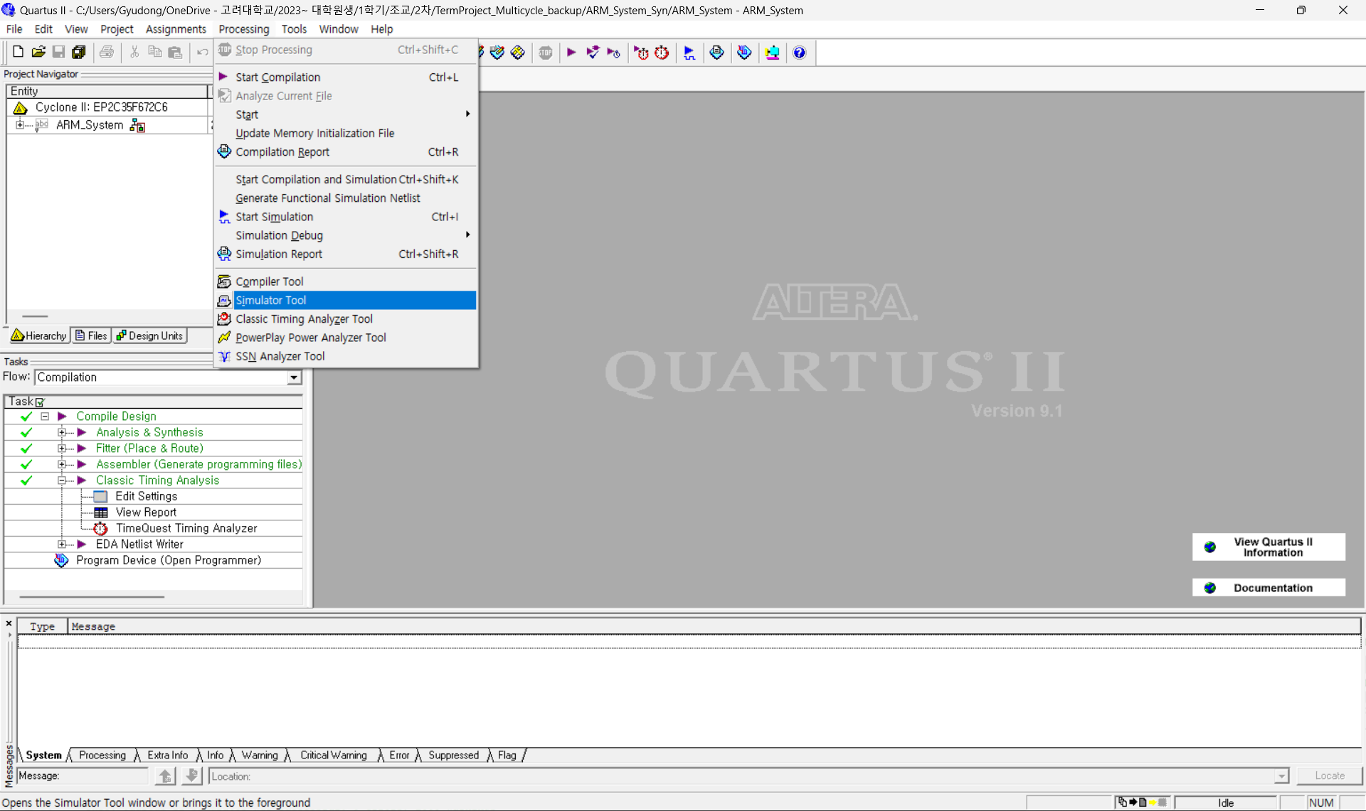
Timing Simulation

Slide 17
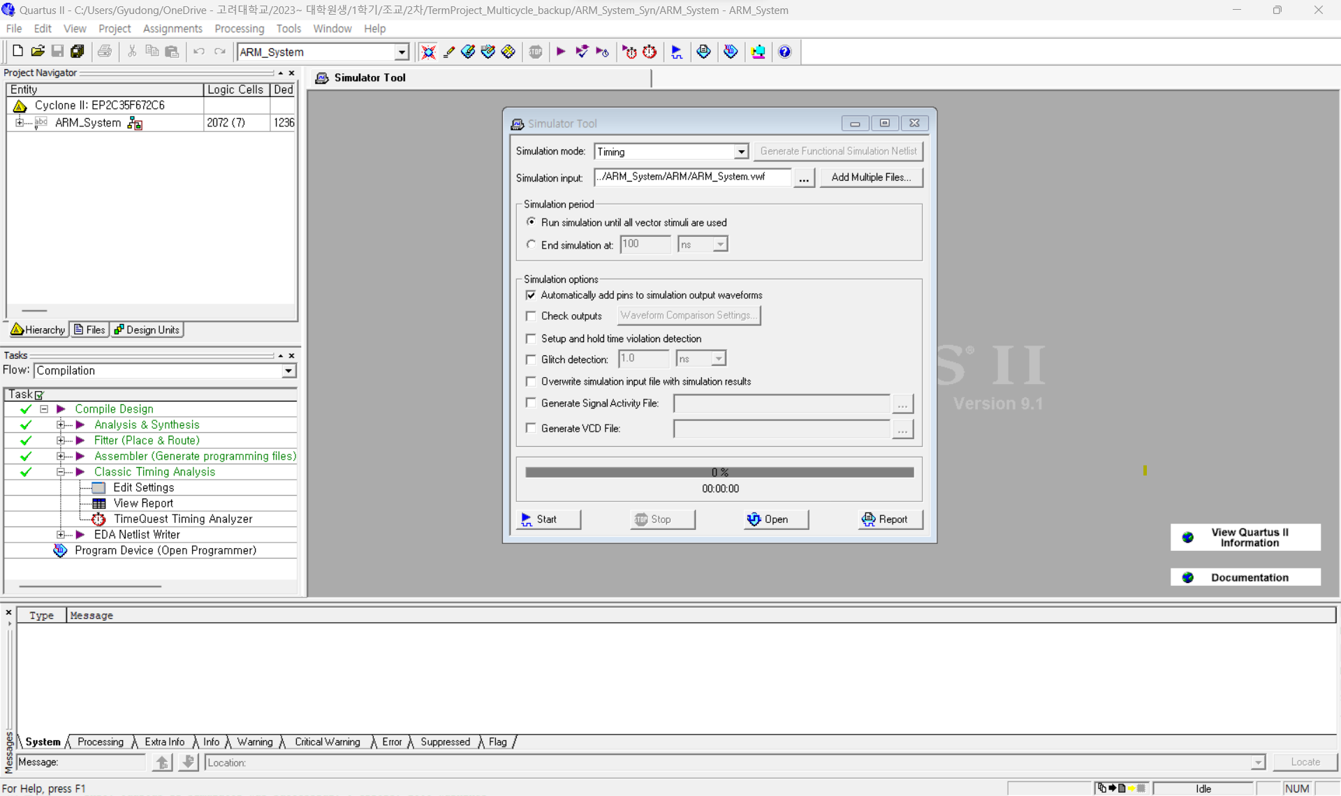
Timing Simulation

Slide 18
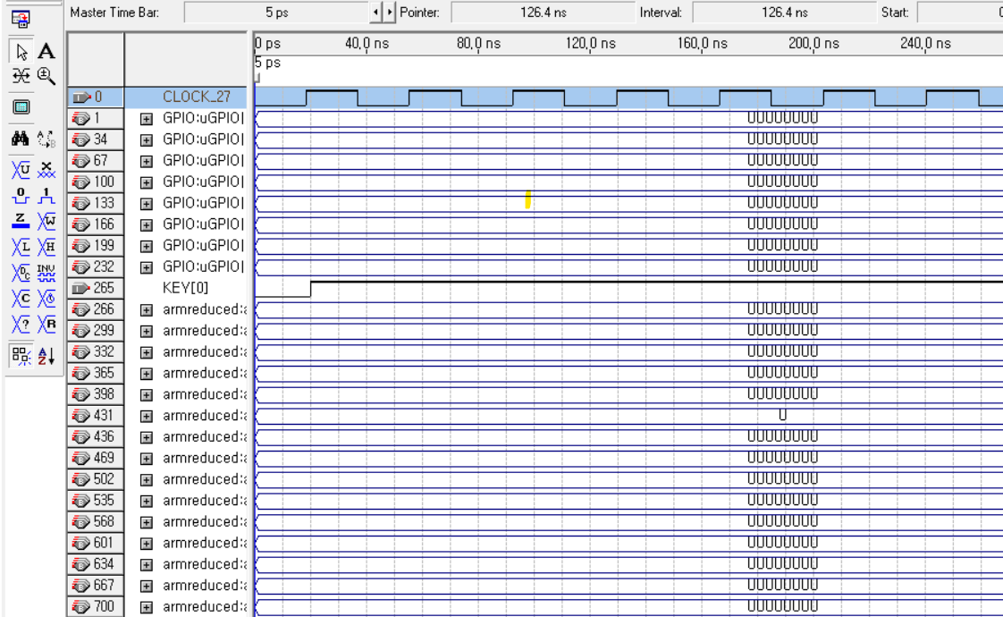
Timing Simulation
: you can force high button
: you can check the time range

Slide 19
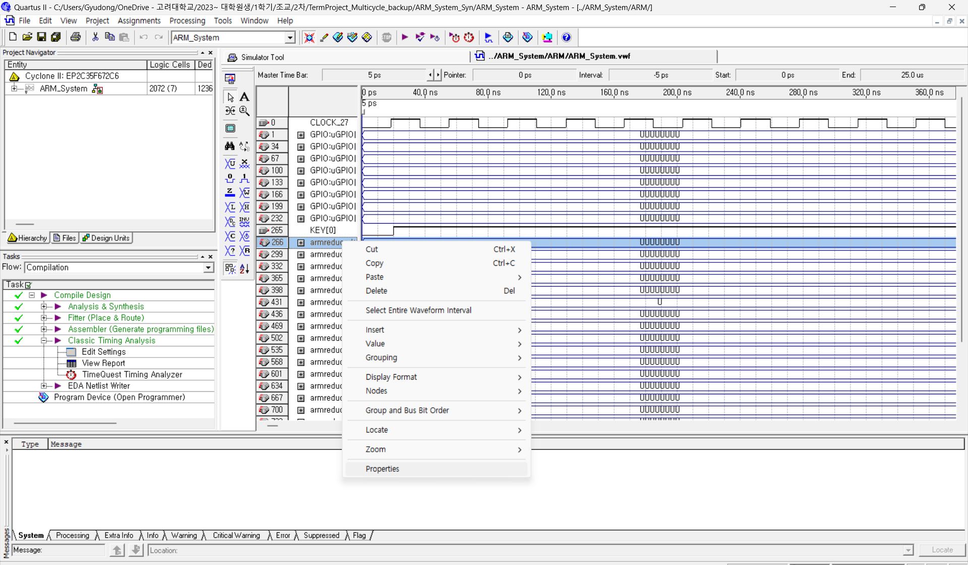
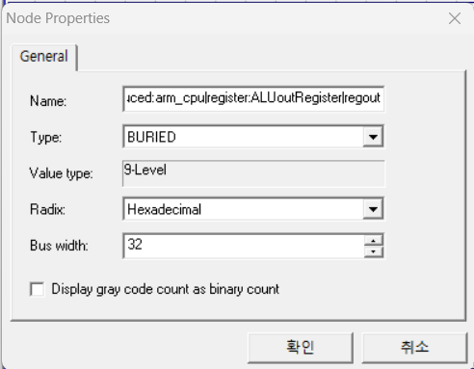
Timing Simulation

Slide 20
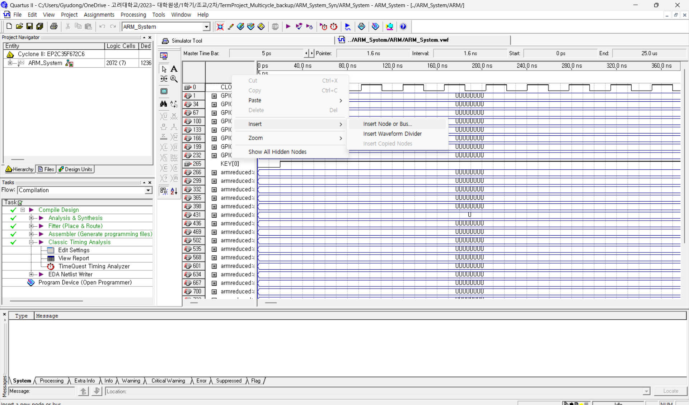
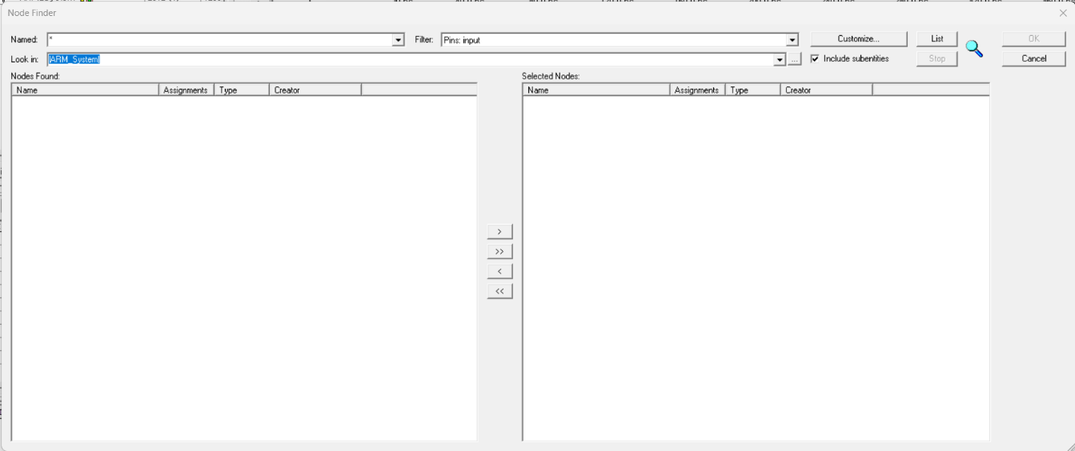
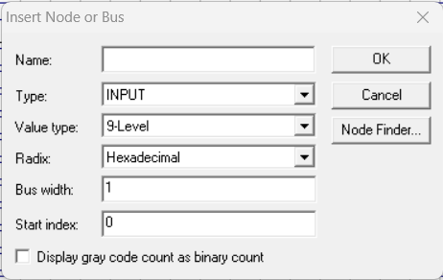
Timing Simulation

Slide 21
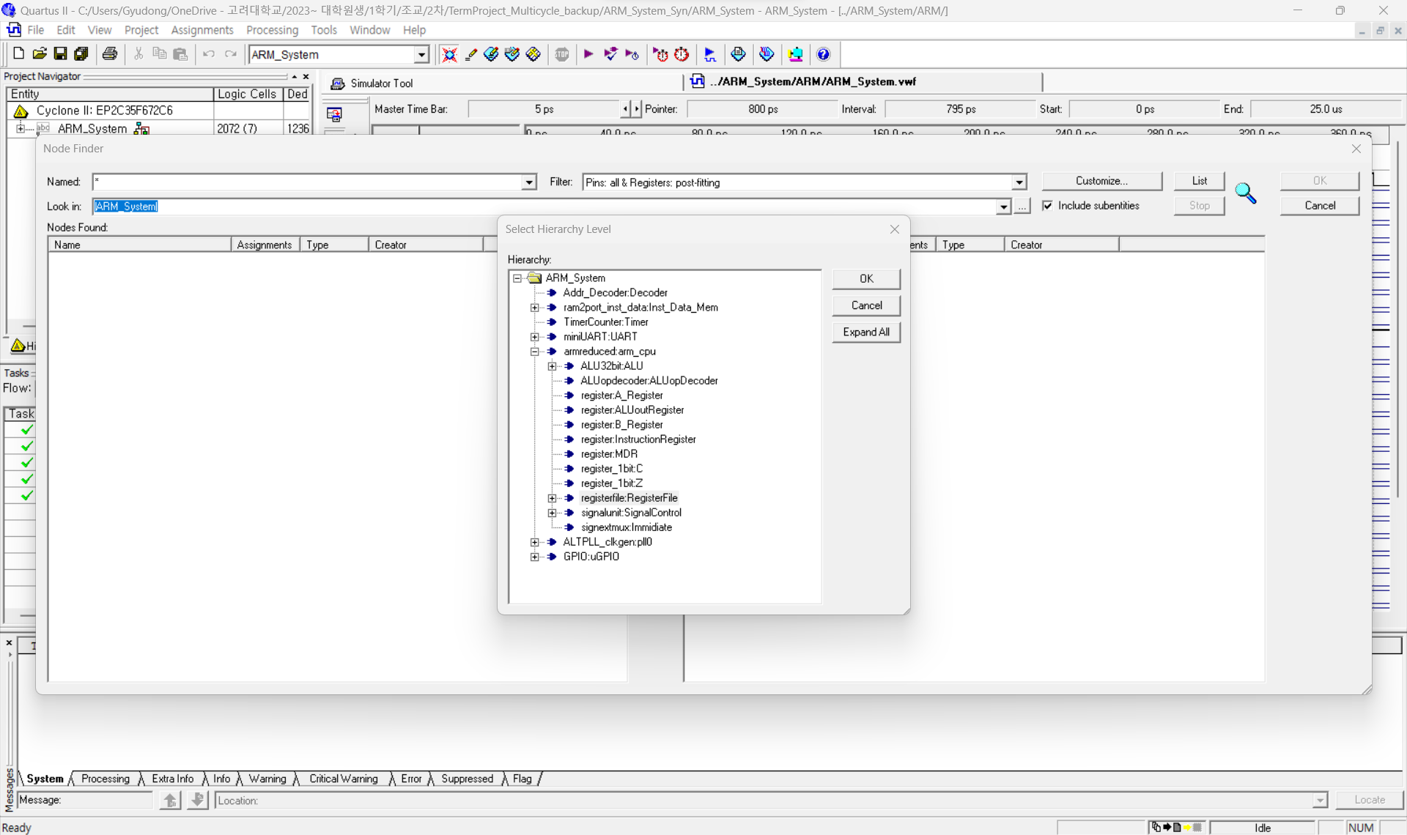
Timing Simulation

Slide 22
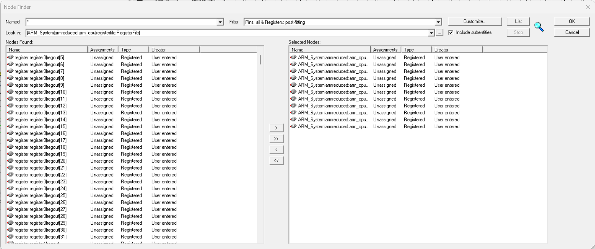
Timing Simulation

Slide 23
Timing Simulation

Slide 24
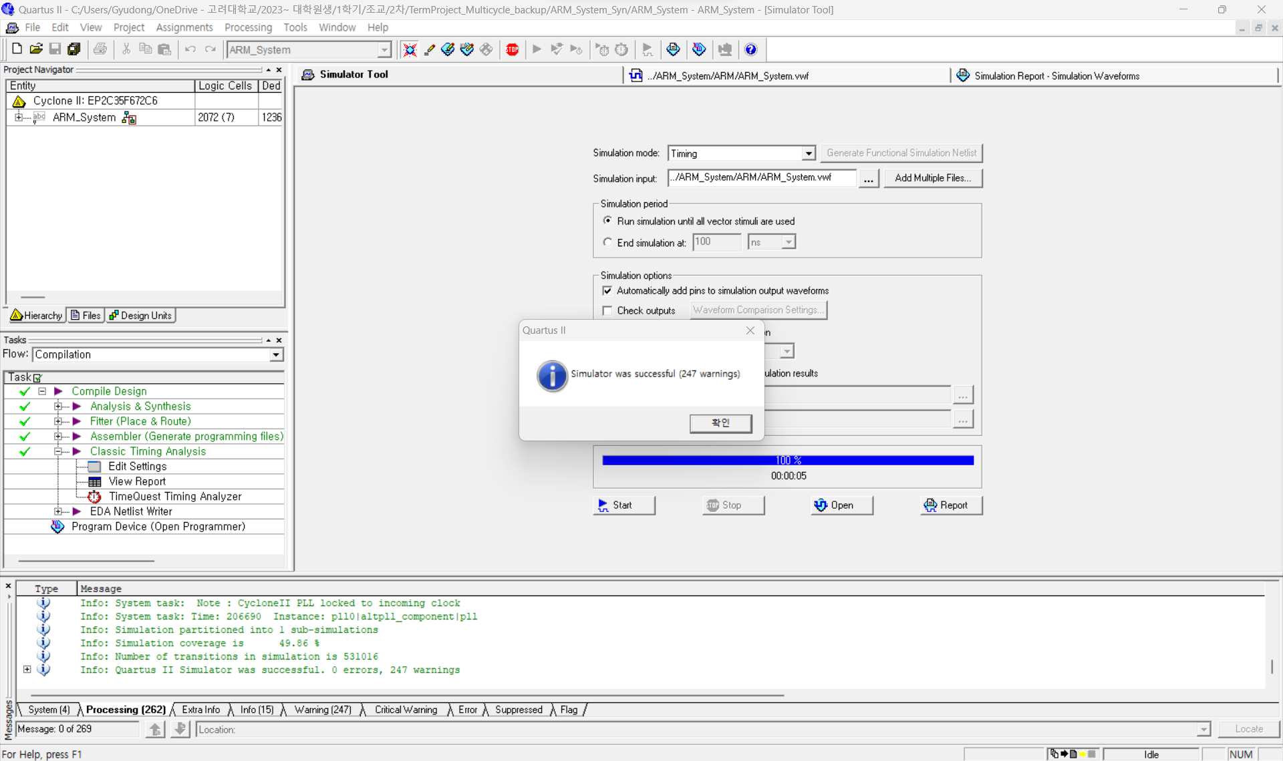
Timing Simulation
LEDG7 is not turned on
when SW1 and SW0 are turned off
LEDG7 is turned on
when both SW1 and SW0 are turned on

Slide 25
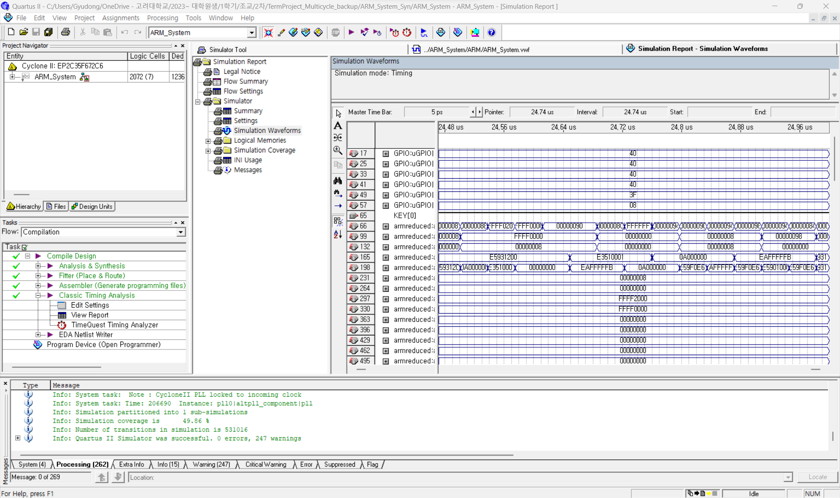
Timing Simulation

